Slide 1
Ops Hub SQL Builder Library
Quick Guide
Nick Woodland
Deployment Team
9/18/2014

Slide 2
The Operations Hub SQL Builder Library
The Operations Hub announces the SQL (Structured Query Language) Builder Library.
Structured Query Language, or SQL, searches for specific situations during map creation and during map quality checks.
Building valid queries takes considerable time, attention to detail, and skill, and one query can be useful in many different projects.
The Operations Hub SQL Builder Library does not replace the Atlas SQL Builder: it complements the Atlas SQL Builder by providing centralized storage and retrieval of queries, eliminating the need for project leads to continually re-create queries that are commonly used.
Project experts have created the queries currently housed in the SQL Builder library. They are arranged by Map Object (Condition, POI, Nav Link, etc.) and Map Attribute. All columns in the table are sortable.
The SQL Builder library allows users to sort and search for an existing query, to build a new query using specific FC parameters, and to request that a new query be added to the library.
The Operations Hub SQL Builder Library was designed:
in response to heightened interest in the use of SQL, as evidenced by entries to the Global Best Practices Program
to accommodate the greater focus on Critical Attributes as part of our Quality activities
specifically for Project Owners, Project Leads and other project experts who desire consistent use of SQL as part of project processes

Slide 3
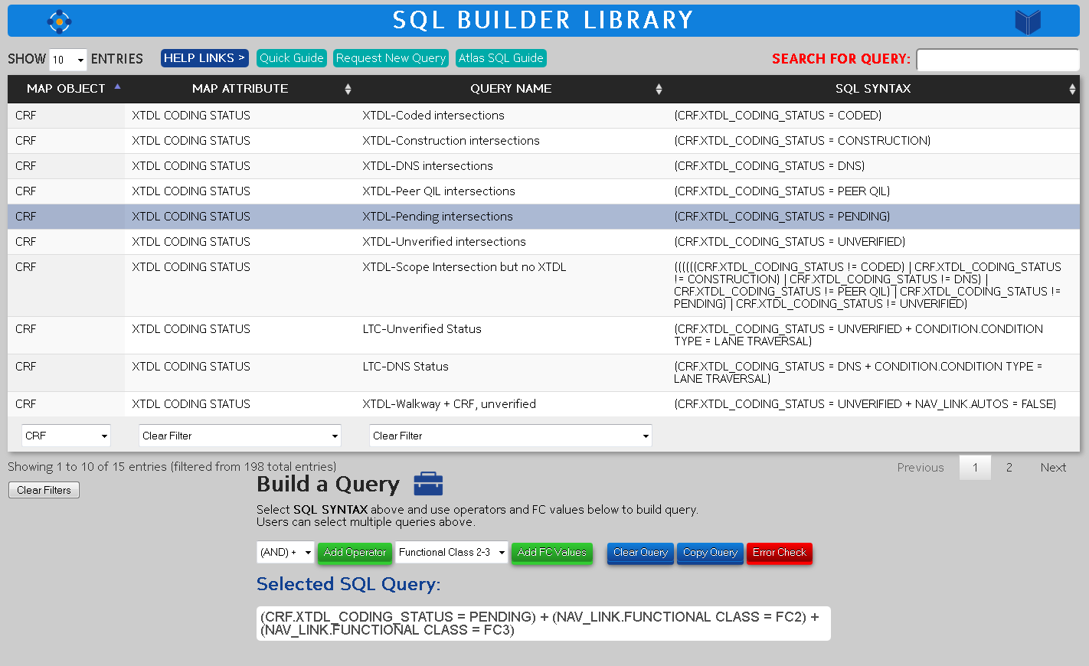
STEP 1 – Tips for finding queries in the table.
All column headers are sortable by clicking on the heading name. Watch the arrow colors to keep track of what is sorted.
Use the Search tool.
These three columns are filterable. Important filtering info:
1: Use one or another to find the query you need.
2: If you filter on the first column, the second filter will still show ALL items in the table (even though the table is filtered).
3: Use the Clear Filters button to clear all filters.

Slide 4
STEP 2 – How to add the query to the Builder.
User selects query in the SQL SYNTAX column by clicking in the cell.
Query is then added to the Selected SQL Query section below.

Slide 5
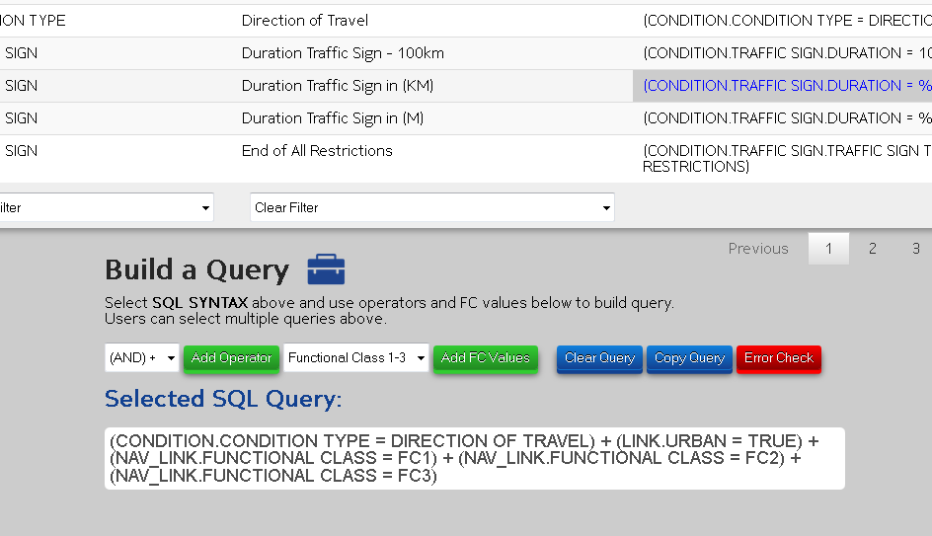
STEP 3 – How to use the Builder tool.
When building queries, you must add appropriate operators. Use the drop-down to select the operator ([AND +] and [OR | ]). IMPORTANT – you must use the button to add the operator.
Adding ‘user-defined’ Functional Class values is much like adding operators. Use the drop-down to select values. IMPORTANT – you must use the button to add the FC values.
1: Clear Query: allows user to clear the selected query if needed.
2: Copy Query: easy window displaying your finished query for copy and pasting into other applications. Triple click query to Select All.
3: Error Check: run this to find any mistakes in your finished query.

Slide 6
Other Tips & Tricks.
Click the Help Links to show the options.
1: Quick Guide for access to this document.
2: Request New Query to open an email for sending new query requests.
3: Atlas SQL Guide for access to the Atlas SQL Builder user guide on the Content Server.

Slide 7
Visit the SQL Builder Library
VISIT THE SITE

